Slide 1

SAP Analytics cloud training
Anurag Bajaj
Day 7

Slide 2
Agenda – Day 7
Advance Planning and Collaboration
- Value Driver Tree
- Data Actions
- Copy Data Actions
- Scripted Data Actions
- Collaboration
- Digital Boardroom
- Create Agenda and Boardroom presentation
---Break---
Introduction to ML
- Intelligent Enterprise
- What is ML
- What is predictive Model
- How to detect Model
- Types of ML
- Supported Scenarios

Slide 3

Value Driver Tree (VDT)
What is it?
A tree structure which allows visualization of composition of KPIs and its contributing factor
A VDT shows how a KPI is calculated from Another KPI in planning model
In SAC, a VDT can be used to visualize existing data but also simulate the impact of change of a driver on other account dimensions.
In Planning, a VDT can be used to create and simulate different scenarios
VDTs are provided as standard story widgets and seamlessly integrated into SAC Stories
A VDT is a standard Widget
VDT can be configured like any other story widget by adding new component and using the panel
VDT takes data from a planning model of type classic (which has account dimension). The nodes of this tree is composed by using the account dimension
We can generate a VDT automatically also
Alternatively we can build it from scratch
www.anubhavtrainings.com

Slide 4
VDT Scenario 2
We would like to calculate Net sales of a company, the Net Sales depends on Gross Sales and Discounts. The Gross Sales will be calculated based on Quantity and Price which further depends on other factors.
The price of a product is decided by price index (CPI) which is an indicator of inflation. The Quantity depends on our sales ambition and growth Rate.
Once we get the gross sales, we subtract the same from discount. The discount depends on a factor of %.
Sales = Quantity (~Market Growth%, ~Sales Ambition) X Price (~Price Index)
Net Sales = Sales – Discount (~Discount%)
Price
Price
Index
Gross Sales
Sales
Ambition
Quantity
Net Sales
Growth
Rate %
Discount
Discount
%
www.anubhavtrainings.com

Slide 5

Data Actions
Used for automating work in SAC planning. They helps end users/planning experts to perform complex tasks with the click of a button.
e.g. if we would like to distribute, allocate, copy, calculate data in planning model, the user needs to do that manually by changing values in report, or needs to have deep understanding of SAC.
You as SAC planning consultant can automate this work with data actions. End user, will just click on a button and the work will be done.
https://help.sap.com/viewer/00f68c2e08b941f081002fd3691d86a7/release/en-US/afe93e3cf1414a7b8419baad11cc066e.html#loioafe93e3cf1414a7b8419baad11cc066e__data_resultlookup
www.anubhavtrainings.com

Slide 6
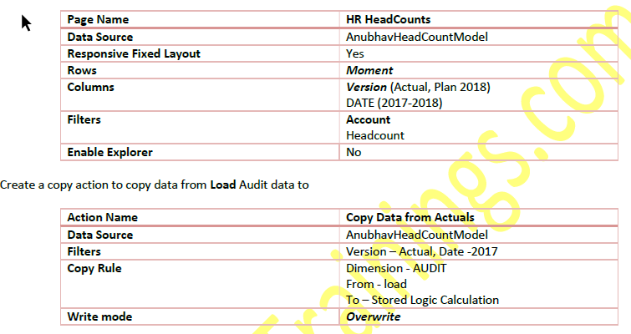
Requirement 1: Copy Data Action
Create Story action to copy the data of 2017 headcount to 2018 plan version
www.anubhavtrainings.com

Slide 7
Requirement 2: Auto calculate headcounts based on Scripting based actions
Finally, we would like to calculate the headcounts based on Hires and Terminations. For calculation, we have to set the opening balance to the ending balance of previous period and Add new hires and subtract the terminations to calculate the final balance. These set of actions needs to be repeated for entire duration on MoM basis.
This is performed using the scripting-based actions, for the ease of writing Anubhav will also show Visual way of writing the script.
CONFIG.TIME_HIERARCHY = CALENDARYEAR
CONFIG.FLIPPING_SIGN_ACCORDING_ACCTYPE = OFF
CONFIG.GENERATE_UNBOOKED_DATA = OFF
MEMBERSET [d/Date] = (BASEMEMBER([d/Date].[h/YQM], "2018"))
FOREACH [d/Date]
DATA([d/MOMENT] = "OPENING") = RESULTLOOKUP([d/MOMENT] = "CLOSING", [d/Date] =
Previous(1))
DATA([d/MOMENT] = "CLOSING") = RESULTLOOKUP([d/MOMENT] = "OPENING") +
RESULTLOOKUP([d/MOMENT] = "HIRES") - RESULTLOOKUP([d/MOMENT] = "TERMINATIONS")
ENDFOR
www.anubhavtrainings.com

Slide 8
What are all the challenges for CEO of a co?
Insight with a simple click
Taking decisions
Planning for future
Real-time information
Resource management
Different perspective at same time
Transparency
Fin
S/4HANA
Procure
Ariba
HR
SuccessFactors
Sales
Hybris Sales Cloud
Marketing
Sales Force
Travel
Concur
www.anubhavtrainings.com

Slide 9
Collaboration
Calendar
Comments
Share
www.anubhavtrainings.com

Slide 10
Why Digital Boardroom.
Since our company is using different solutions, SAP & Non-SAP with heterogeneous technologies, the data, people and processes are distributed. Due to this there is a Lack of transparency and coordination between departments.
CEO or the Board of the co. want is a transparent and connected insights.
SAP Digital Boardroom = SAC (Sales), SAC (Marketing), SAC (Travel)
www.anubhavtrainings.com

Slide 11

Digital Boardroom - Benefits
Total transparency
Instant data driven insights
Simplified boardroom processes
Get a complete picture of the company situation in real-time
Visualize in-context insights to maximize impact on the audience
Align executive decisions on one source of truth across business areas
Answer ad-hoc questions on-the-fly to better understand the business performance
Analyze root causes to identify business risks and opportunities in real-time
Simulate impact of potential decisions to financials and operations
Transform the boardroom experience for better outcomes
Reduce boardroom meeting preparation time and effort
Leverage predefined best practices to accelerate time to value
www.anubhavtrainings.com

Slide 12

Benefits
Contextual user experiences
Guided or free structure
Data-driven insights
Give executives a complete, real-time view of company situations and KPIs across departments – and foster trust among leaders
Align executive decisions on one source of truth across business areas
Embedded and personalized to each individual
Follow a traditional presentation structure with the ability to break-off, skip, or go back
Create a freeform presentation in a new exploratory style to meet your organizational structure
Explore and combine KPIs, and use filters to compare trends and spot correlations
Simulate impact of potential decisions to financials and operations
Get a 360-degree view and visualize insights in context across multiple touchscreen displays to maximize impact
www.anubhavtrainings.com

Slide 13
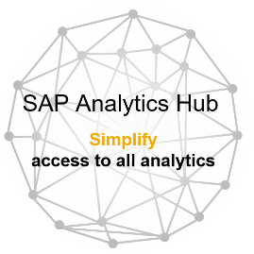
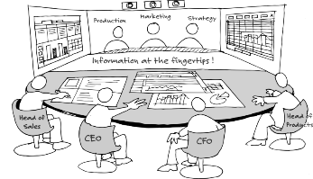










Use Case
SAP Analytics Cloud
SAP Digital Boardroom
Total Transparency
Instant Data-Driven Insights
Simplified Steering Meetings
All Analytics. All Users. One Product.
SAP Analytics Hub
A single entry point to find the analytics you need
Business Intelligence
Planning
Predict
Chart & Crosstab
Aggregation/Allocation
Time series forecast
Drill up & down
Version Management
Smart Insight
Geo Map
Workflow/Input Tasks
Smart Discovery
Explorer
What if Simulations
Smart Predict*
Core functions
Real-time data access
Model management
Collaboration
Mobile Access
Authentication・SSO
Data security
Data acquisition
Data Manipulation
Event / Calendar
API
Deployment
Monitoring
SAP Business Objects
www.anubhavtrainings.com

Slide 14
Data coming in SAC
S/4HANA
Finance
Hybris
eCommerce
Digital Boardroom
Field Glass
Contractor
Success Factors
HR
Office Locations
Geo Coordinates
Concur
Travel and Exp.
www.anubhavtrainings.com

Slide 15
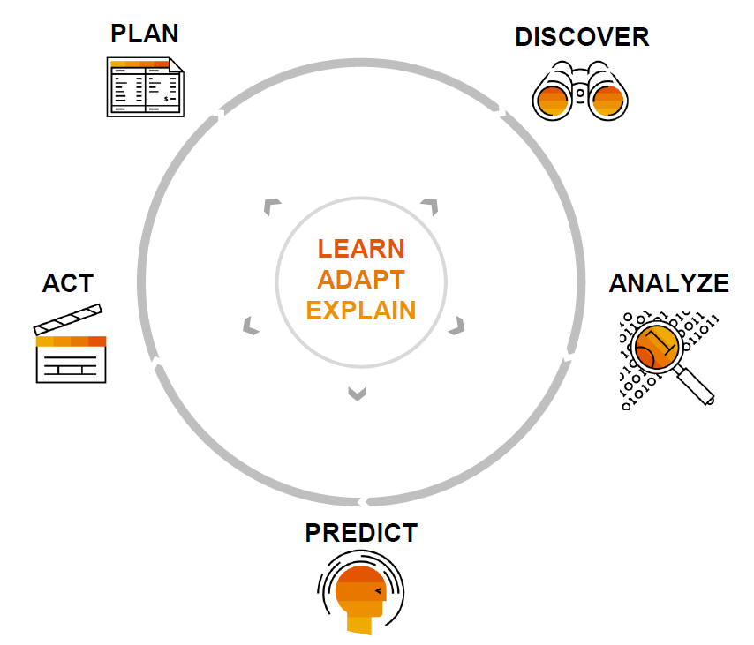
How decision making happens?
Employees
Act accordingly
Data engineer
Collect and track
Decision Makers
CEO’s office
Data scientist
analyze
Data scientist
Predict using models
www.anubhavtrainings.com

Slide 16
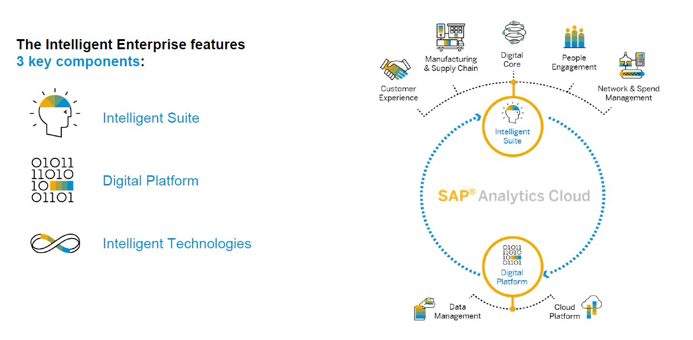
SAP Intelligent Enterprise Strategy
www.anubhavtrainings.com

Slide 17
What is Machine Learning
It is a field of study that gives computers the capability to learn w/p being explicitly programmed.
e.g. Amazon
Is there any human who is sitting behind the scenes and checking your browsing history and favorable products to prepare the webpage as per your choices?
Huge human effort
data
Computer
Output
data
Computer
Program
Model
Rule
program
Expected Output
www.anubhavtrainings.com

Slide 18
Example
Marks | Result
9 | Pass
2 | Fail
3 | Fail
5 | Pass
8 | Pass
4 | Fail
7 | Pass
3 | Fail
5 | Pass
7 | Pass
4 | Pass
2 | Fail
Computer
Machine Learning
Tries to identify the best possible combination of the data
If Marks > 3
Then PASS
Else FAIL
--- Model
actual
predicated
Marks | Result
3 | Fail
5 | Pass
7 | Pass
4 | Pass
2 | Fail
Marks | Result
3 | Fail
5 | Pass
7 | Pass
4 | Pass
2 | Fail
If Marks > 3
Then PASS
Else FAIL
--- Model – 60%,90%
Marks < 3 FAIL else PASS
www.anubhavtrainings.com

Slide 19
Techniques to determine the model
Modeling is a process by which machine learning tries to find/create best model for our use case. The model is created to predict the outcome (predicted output). Model evaluation is an integral part of model development process (comparing validation dataset with predicated dataset). In order to find the best model, there are so many ways (these are called mathematical algorithm)
2 ways to use to detect the model
Hold-out
The entire data set (where outcome is known) into 2 parts. 1. Training data set 2. Validation dataset
With the help of training dataset by applying different techniques, we can derive the best possible model. Once the model is determined, the validation dataset will be used to compare the predicted v/s actual to get the accuracy determined. Generally higher the data better the accuracy.
Cross Validation (low volume of data)
When only limited data is available. The system will divide the data in k parts. Each k set will be sent for sampling and clustering.
www.anubhavtrainings.com

Slide 20
Types of ML
Supervised ML
Train the model ➔ Model. Validate, Retry, Retrain
Algo: Decision Trees, Native Bayes, Logistic Regression, Linear/Multi Regression, SVM….
Unsupervised ML
Let the machine work like a child and explore the huge amounts of data and make the model by itself.
Algo: k-means, hierarchical, apriori, generic algo, time series….
Re-inforcement Learning
Candy-stick approach
If you do good – candy
If you do bad – stick
Robotics
www.anubhavtrainings.com

Slide 21
Analytics v/s Predictive Analytics
Analytics – is used to create visualization on historic data which just gives us an overview and an insight.
Predictive Analytics – when we want to determine an event to occur in future, a value of a dimension in future, it is considered as predictive analytics. The field which will help us to achieve is Machine learning. With this we get Vision.
Choosing the right amount, and kind of data for prediction is very important.
Before we start ML with SAC, any use case given to us, we need to ask following
Business Need
Business Goal
Output expected by Decision we make
Which Scenario
Classification
Regression
Time Series
www.anubhavtrainings.com

Slide 22
End of Day 7

Slide 23

Questions

Slide 24

Anurag Bajaj
anurag.bajaj02@gmail.com

